Slide 1

FOREST CARBON ANALYSIS
THE IMPACT OF FOREST CARBON ON CLIMATE CHANGE

Slide 2

INTRODUCTION
Climate change is a significant threat to the environment on a global scale, with carbon dioxide being it’s main agent.
Our forests can serve to aid or deter this threat. Forests can mitigate the world’s carbon problem by absorbing the atmosphere’s carbon and storing it or they can intensify the problem when they emit carbon into the atmosphere through various forms of deforestation and decay.
This project is designed to analyze the world’s forest carbon metrics and devise data-driven solutions to aim the weapon of forest against the enemy that is climate change.

Slide 3

DATA ANALYSIS – TOOLS & METHODS
Python was used for manipulating data, data exploration and data visualization to discover insights and trends.
Microsoft Power BI was used to design interactive dashboards for data visualization to re-affirm insights and trends obtained in prior analysis.
Microsoft PowerPoint was used to create data story to presents findings in clear and concise format.

Slide 4
DATA ANALYSIS – DEFINING FEATURES
Dataset contains 702 rows and 30 columns;
Column features:
Country – contains list of 234 countries
umd_tree_cover_density_2000__threshold – contains values of land area with tree canopy cover categorized by different thresholds (30, 50, 75).
umd_tree_cover_extent_2000__ha – total area covered by trees in hectares
gfw_aboveground_carbon_stocks_2000__Mg_C – Amount of carbon stored in aboveground biomass of trees in Megagrams of carbon
avg_gfw_aboveground_carbon_stocks_2000__Mg_C_ha-1 – Average amount of carbon stocks per hectare in megagrams per hectare
gfw_forest_carbon_gross_emissions__Mg_CO2e_yr-1 – Total forest carbon emissions per year
gfw_forest_carbon_gross_removals__Mg_CO2_yr-1 - Total forest carbon removals per year
gfw_forest_carbon_net_flux__Mg_CO2e_yr-1 – Net balance of emissions and removal per year
gfw_forest_carbon_gross_emissions_{year}__Mg_CO2e – Forest carbon emissions from 2001 to 2022

Slide 5
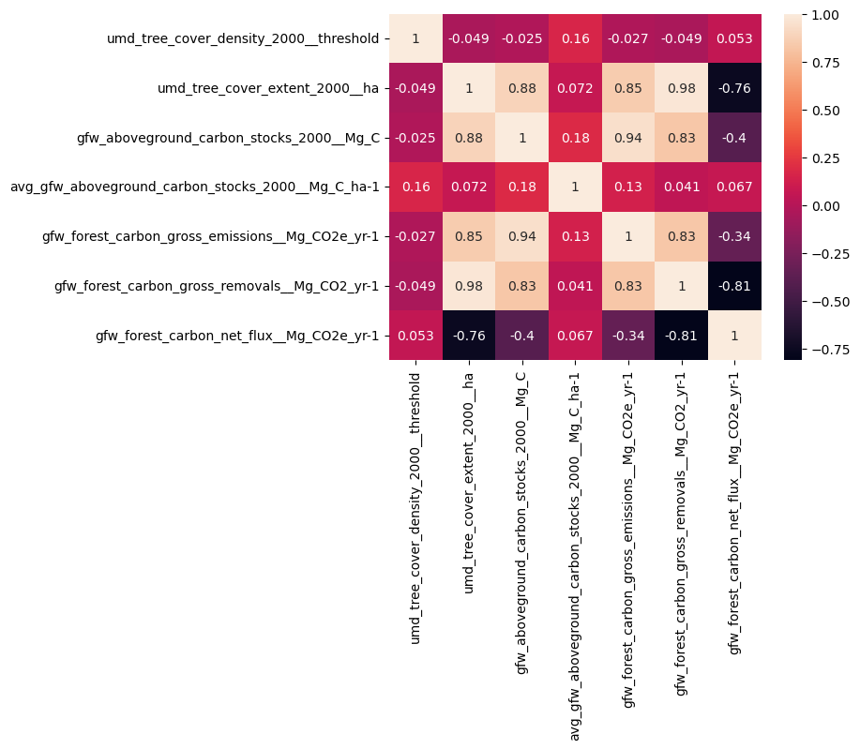
DATA ANALYSIS – CORRELATION
The correlation matrix helps narrow down initial forest carbon metrics of interest for analysis.
Metrics of interest based on correlation;
Tree cover extent in 2000
Aboveground carbon stocks in 2000
Forest carbon emissions per year
Forest carbon removals per year
Forest carbon net flux per year

Slide 6
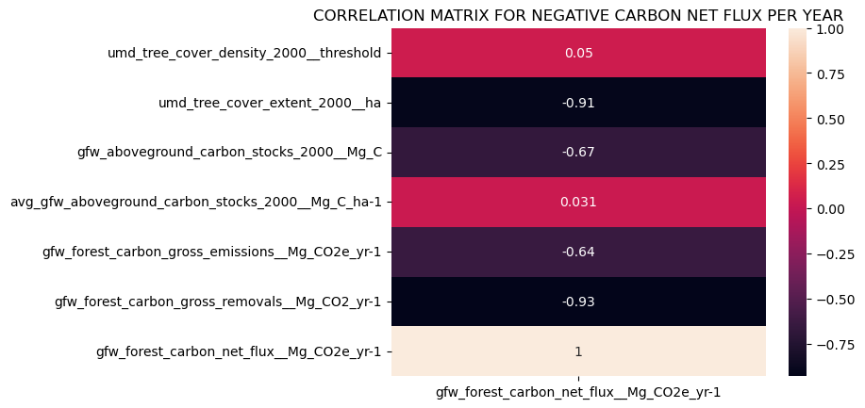
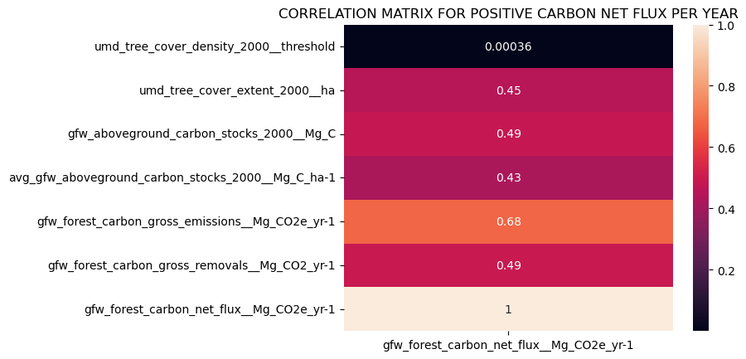
DATA ANALYSIS – CORRELATION
These correlation matrices helps deduce factors correlating to positive and negative carbon net fluxes.
Negative flux show highest correlation to carbon removals per year and tree cover extent.
Positive flux shows highest correlation to carbon emissions per year.

Slide 7
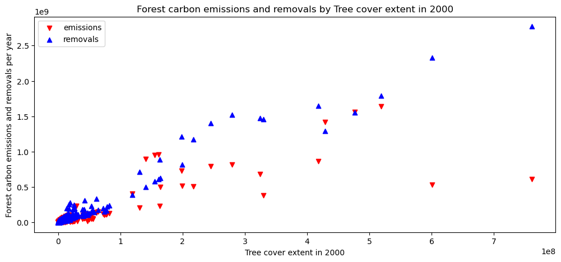
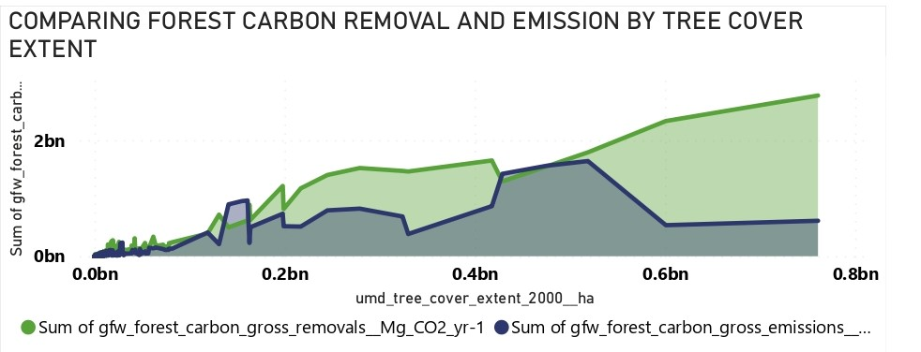
DATA ANALYSIS – VISUALIZATIONS
Exploring relationship between forest carbon emission and removal with tree cover extent in 2000.
The two visuals show forest carbon removal generally greatly exceed emissions(negative net flux) with further increase in tree cover extent.

Slide 8
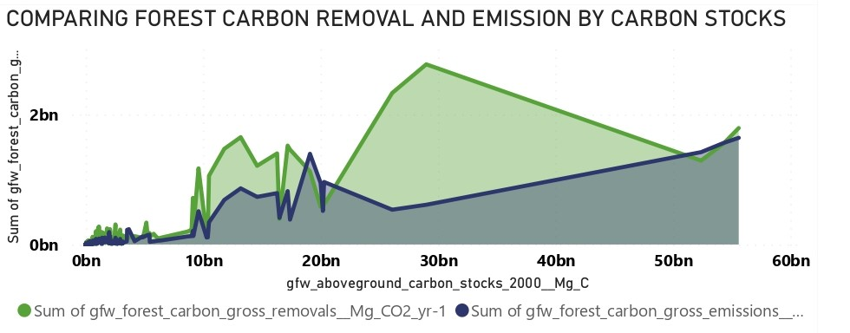
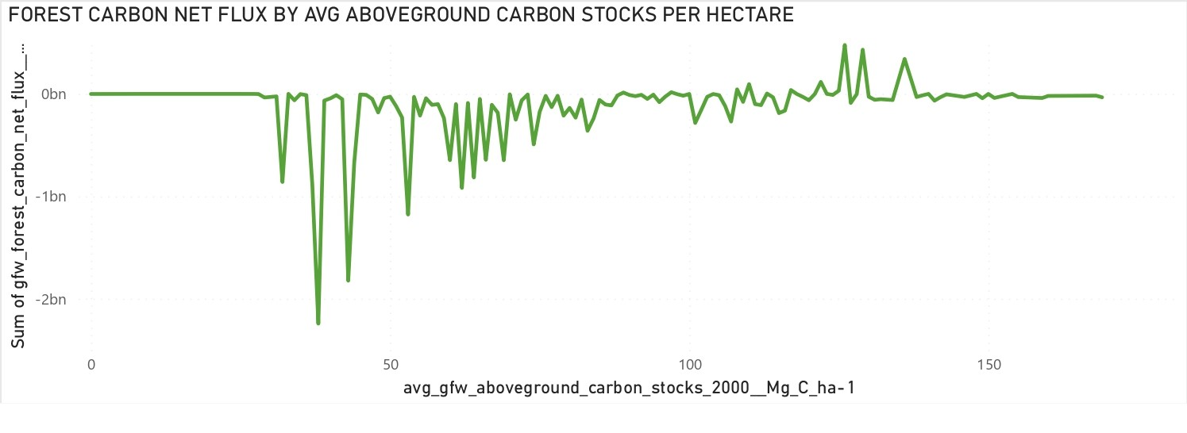
DATA ANALYSIS – VISUALIZATIONS
Here, the carbon removal for most cases get much higher than carbon emissions as aboveground carbon stocks increase.
This visual shows carbon net flux turning more positive(emission > removal) with increasing average aboveground carbon stocks per hectare.

Slide 9
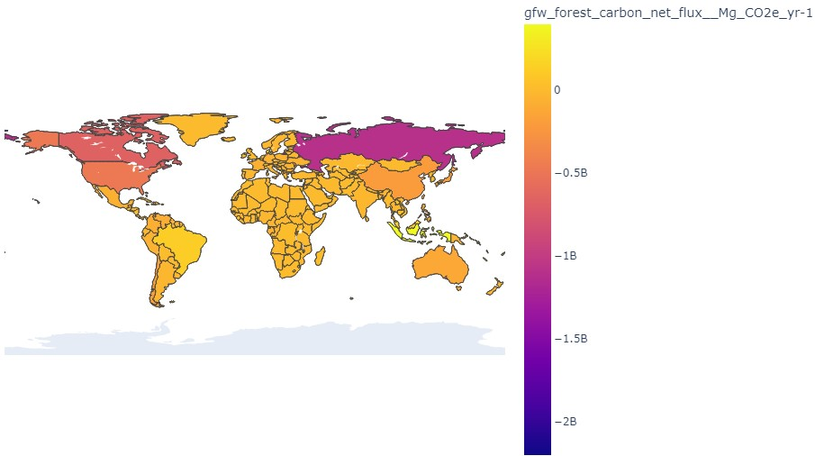
DATA ANALYSIS – VISUALIZATIONS
Forest carbon net flux per year of countries.

Slide 10
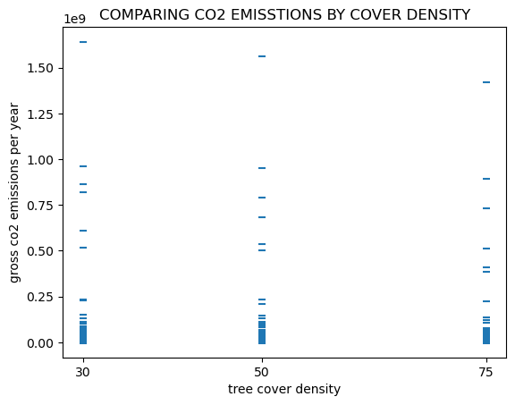
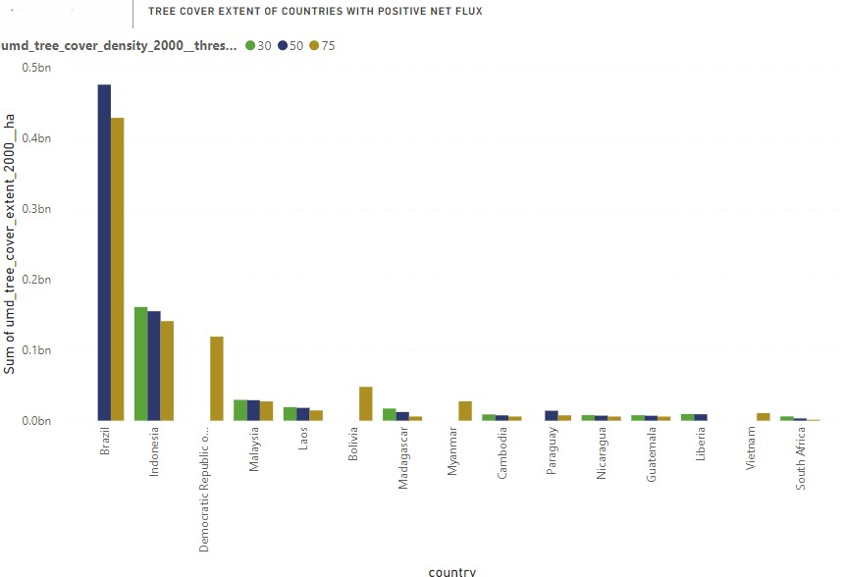
DATA ANALYSIS – VISUALIZATIONS
Tree cover extent of countries with positive carbon net flux(emission > removal) with specified tree cover threshold density.
Distribution of forest carbon emission per year by tree cover density threshold.

Slide 11
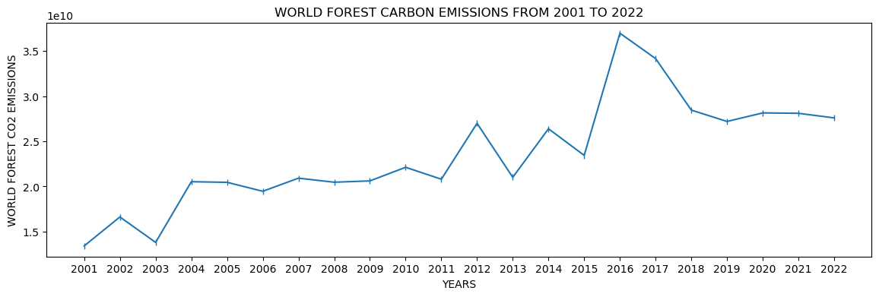
DATA ANALYSIS – VISUALIZATIONS
Total forest carbon emitted worldwide from 2001 to 2022.

Slide 12
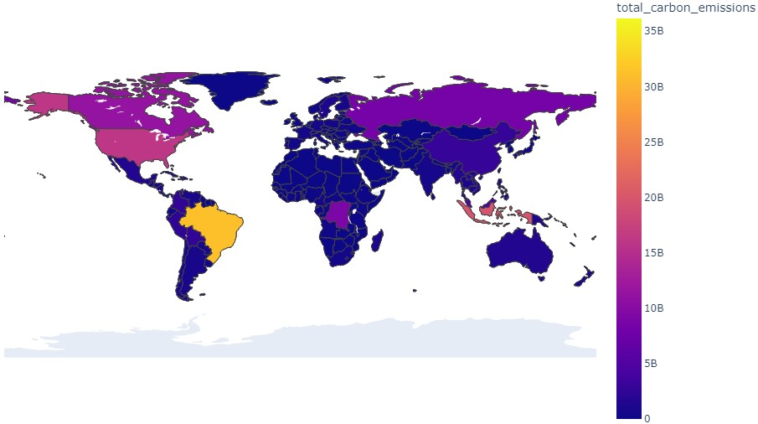
DATA ANALYSIS – VISUALIZATIONS
Total forest carbon emission of all countries from 2001 to 2022.

Slide 13
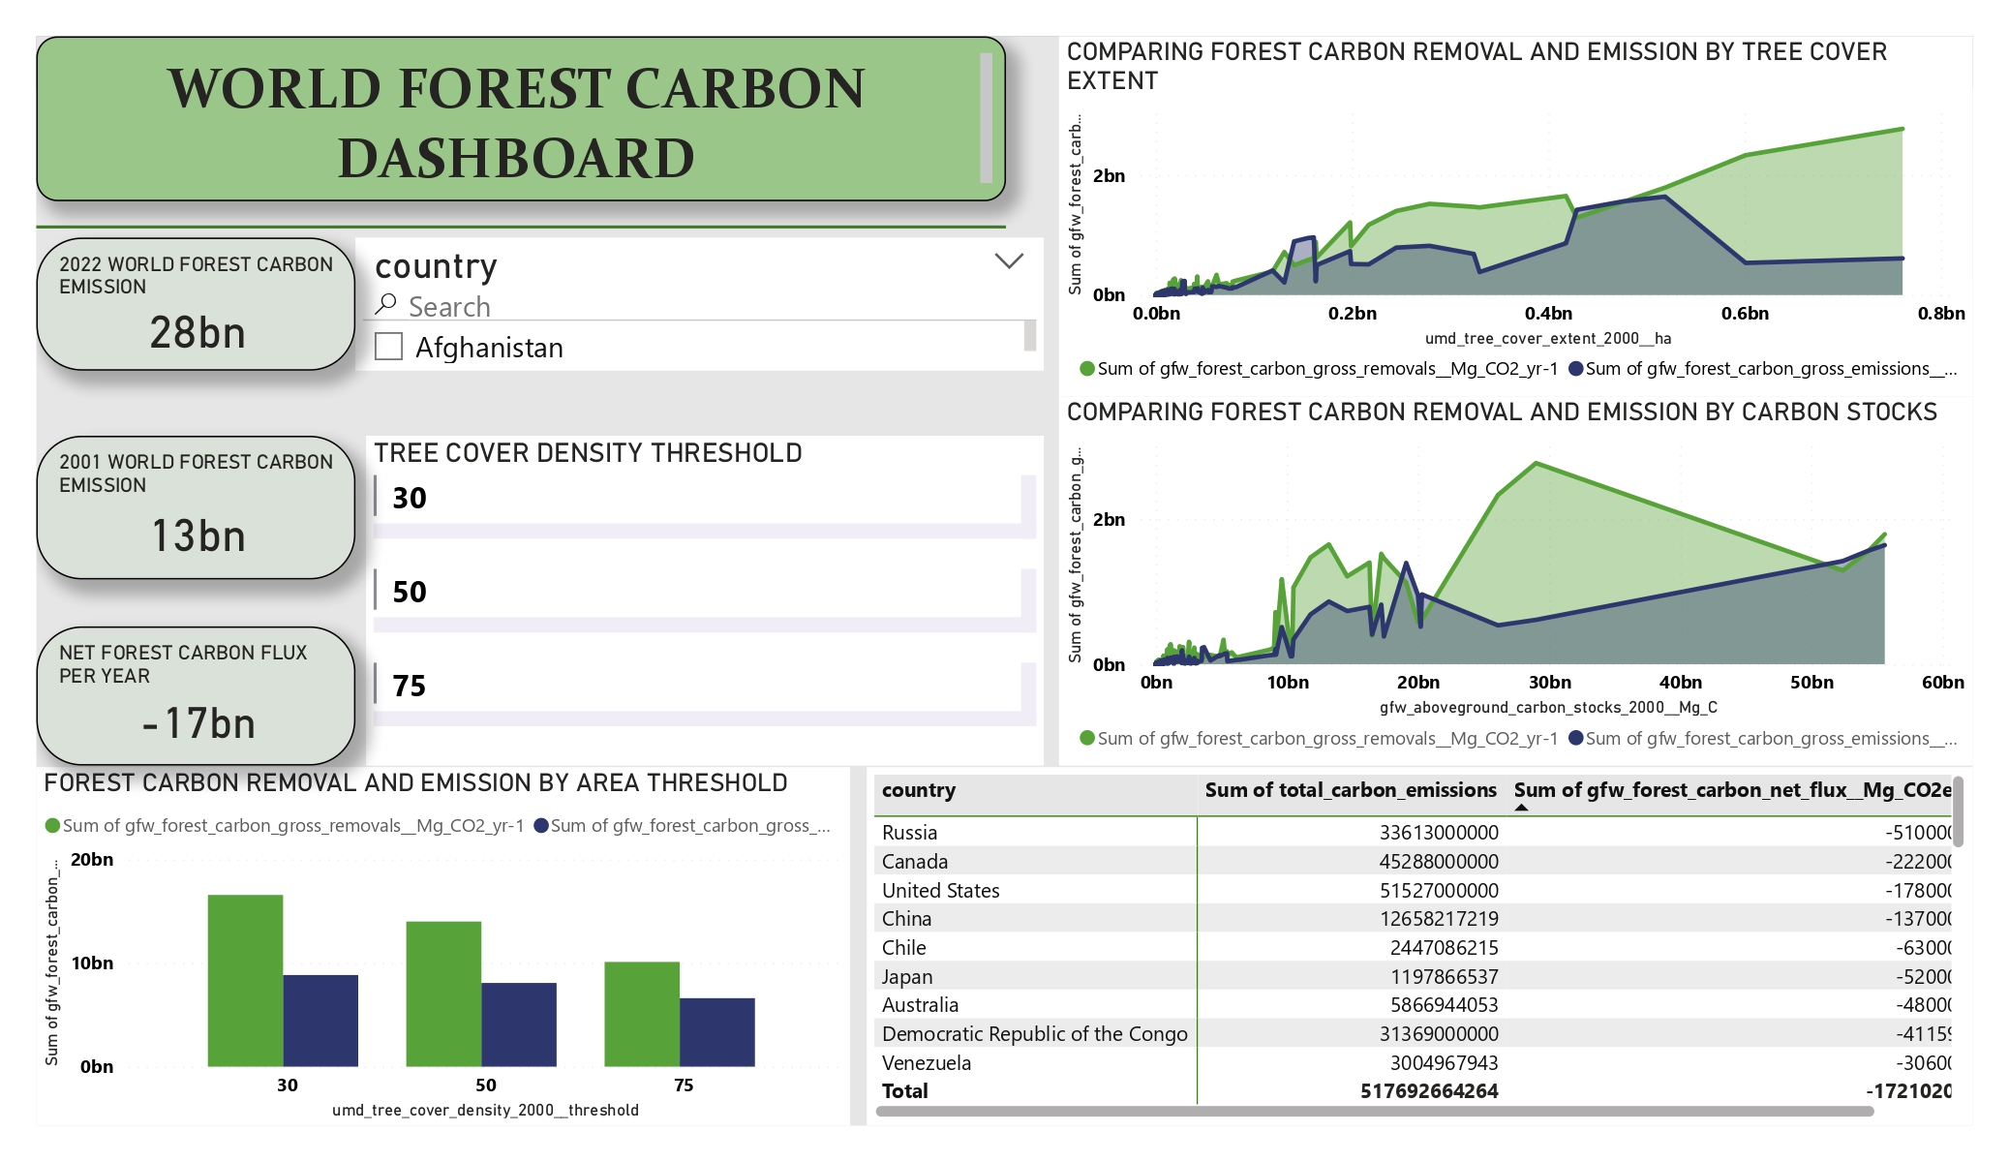
DATA ANALYSIS – DASHBOARDS

Slide 14
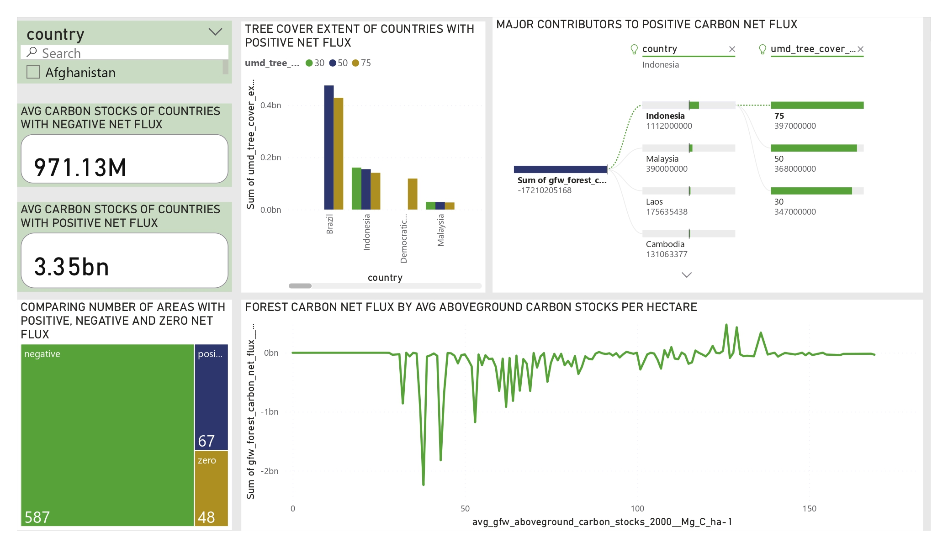
DATA ANALYSIS – DASHBOARDS

Slide 15
DATA ANALYSIS – KEY INSIGHTS
1
2
3
Tree cover extent is a clear major factor in how forests impact the climate change problem.
The data shows that forest carbon net flux become increasingly more negative as tree cover extent get higher, that is when more and more trees exists forests remove much more carbon than they emit to the atmosphere. This is reinforced from observing mostly lower tree cover extent in countries with positive net flux
The carbon stocks factor is an interesting one, as the total carbon stocks and average carbon stocks per hectare have opposing effects on net flux with increment, the ideal balance for the environment would be to increase the total carbon stocks while maintaining the average carbon stock per hectare. This can be achieved through increase in tree cover area.
A gradual increase in the total carbon emissions from 2001 to 2022 was indicated from the data, Brazil is responsible for an outrageous amount of the forest carbon released into the environment. Emissions were also observed to increase with lower tree cover density threshold.

Slide 16
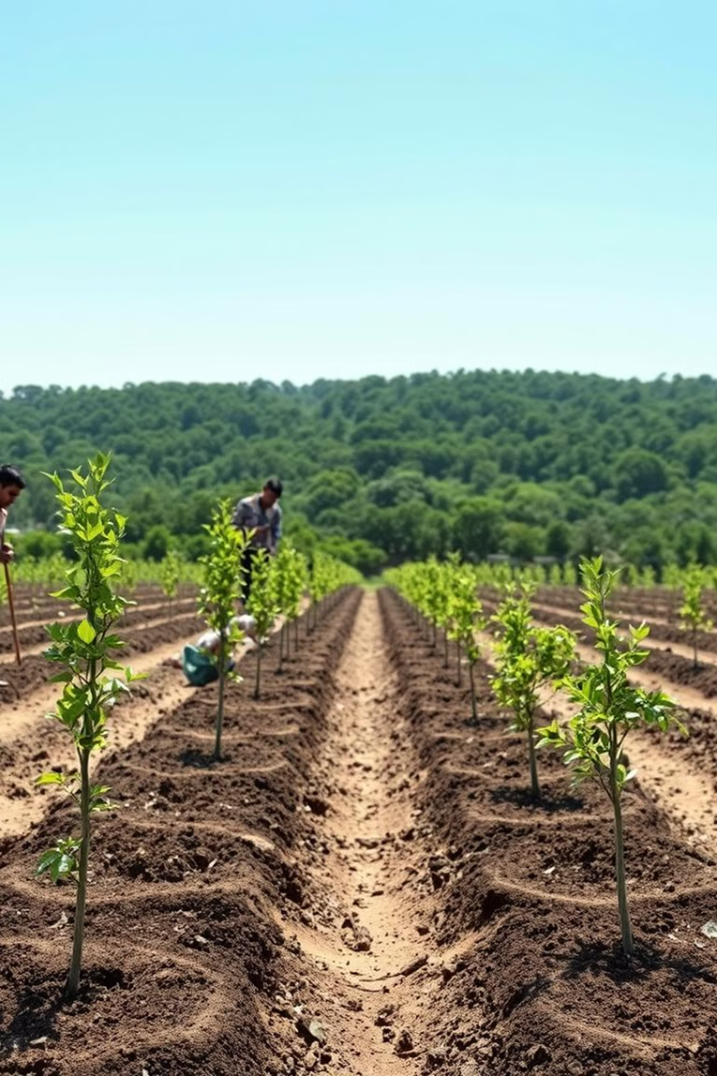
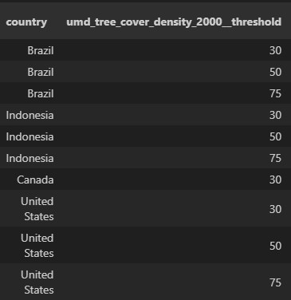
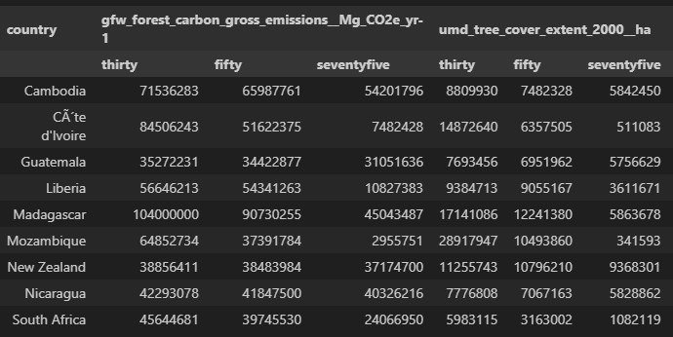
DATA ANALYSIS – PROPOSED REMEDIES
1
AFFORESTATION: Nations with positive or approaching positive forest carbon net flux should be urged to plant more new trees in light of insights on the impact tree cover extent on forest carbon removals.
These are leading areas in forest carbon emission per year and should also be urged to plant more new trees.
These are countries with above world average forest emissions and below average tree cover extent. These countries need to be encouraged to plant more new trees.

Slide 17

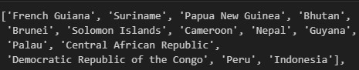
DATA ANALYSIS – PROPOSED REMEDIES
2
CONTROLLED DEFORSTATION AND REFORESTATION: It is impossible for man to survive without exploiting forest resources for our needs, therefore, experts are to be consulted when forest are to be removed or replanted. These experts are needed to control carbon stocks in the forests by increasing the total carbon stocks and maintaining or reducing the average carbon stocks per hectare by extending tree cover area for the purpose of increasing forest carbon removal.
This practice should be encouraged in African and European regions where low forest carbon emissions but approaching positive forest carbon net flux is observed.
These countries should also implement this practice due to having very high average carbon stocks per hectare.

Slide 18
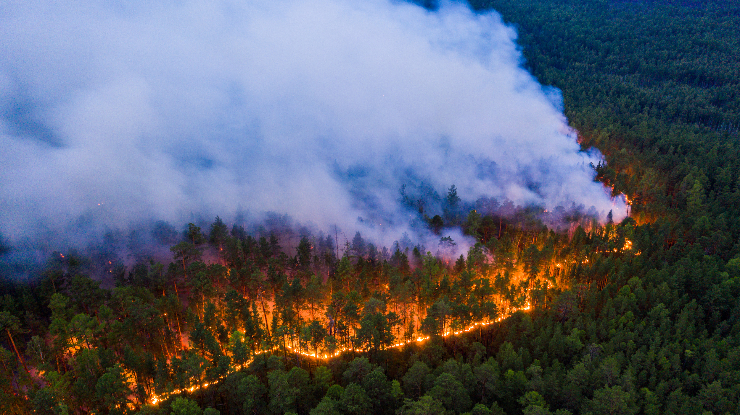
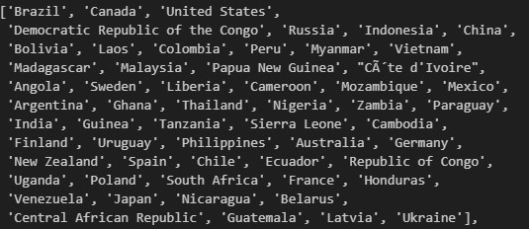
DATA ANALYSIS – PROPOSED REMEDIES
3
FOREST REGULATION ENFORCEMENT: Many countries around the world have laws to protect forest, if these laws aren’t adhered to and enforced properly afforestation and reforestation efforts would be for naught and carbon emission would increase and eventually overtake forest carbon removals completely. Hence, governments and organizations should enforce the existing laws to protect forests from illegal activities.
These are countries who led the world in forest carbon emissions in 2022, these countries must be urged by international bodies to enforce their forest regulations.

Slide 19

DATA ANALYSIS – PROPOSED REMEDIES
4
HARNESSING TECHNOLOGY: As we are well into the 21st century, technology is a necessity in addressing the climate problem. More innovative technologies should be utilized in monitoring forest carbon metrics to optimize afforestation, deforestation and reforestation practices in order to ensure forest carbon removals are much higher than emissions and gain the upper hand against climate change.
5
AVAILABILITY OF INFORMATION: Many know of the effect of climate change on the environment but few know of the impact forests have on climate change. Making presentations like this one, which tells interesting stories with forest data readily available to people everywhere through mainstream media and social media would inform individuals and communities on how they can help the fight against climate change through forests and trees.

Slide 20

CONCLUSION
There are many contributing factors to climate change. Forestry is a factor on the long list, but forest also represent hope in combating this challenge.
This presentation delved into forests contribution to climate change and how they can serve as a valuable weapon against climate change instead of aiding it.
The presentation contributes to the fight against climate change by providing data-driven insights on forest carbon and presenting feasible solutions to the problem.

Slide 21

THANK YOU

